Slide 1
Position Designation Tool Training
Civilian Human Resources Office (CHRO)
U.S. Staffing And Classification Section

Slide 2
Position Designation Tool
WHAT IS THE POSITION DESGINATION TOOL?
THE POSITION DESIGNATION SYSTEM ASSESSES THE DUTIES AND RESPONSIBILITIES OF A POSITION
TO DETERMINE THE DEGREE OF POTENTIAL DAMAGE TO THE EFFICIENCY OR INTEGRITY OF THE SERVICE
FROM MISCONDUCT OF AN INCUMBENT OF A POSITION. THIS ESTABLISHES THE RISK LEVEL OF THAT
POSITION. THIS ASSESSMENT ALSO DETERMINES IF A POSITION’S DUTIES AND RESPONSIBILITIES
PRESENT THE POTENTIAL FOR POSITION INCUMBENTS TO BRING ABOUT A MATERIAL ADVERSE EFFECT
ON THE NATIONAL SECURITY, AND THE DEGREE OF THAT POTENTIAL EFFECT, WHICH ESTABLISHES THE
SENSITIVITY LEVEL OF A POSITION. THE RESULTS OF THIS ASSESSMENT DETERMINE WHAT LEVEL OF
INVESTIGATION SHOULD BE CONDUCTED FOR A POSITION.

Slide 3
Position Designation Tool
OF-8 SENSITIVITY CODING EXAMPLES
PD HAS BEEN DESIGNATED AS NON-CRITICAL SENSITIVE, TIER 1, REQUIRING GOVERNMENT UNCLASSIFIED COMPUTER ACCESS.
BLOCK 12 IN THE OF-8/MARK 1- NON-SENSITIVE.
PD HAS BEEN DESIGNATED AS REQUIRING INCUMBENT TO OBTAIN AND MAINTAIN SECRET SECURITY ELIGIBILITY WITH ACCESS TO CLASSIFIED INFORMATION.
BLOCK 12 IN THE OF-8/MARK 2 – NON-CRITICAL SENSITIVE.
PD HAS BEEN DESGINATED AS REQUIRING INCUMBENT TO OBTAIN AND MAINTAIN TOP-SECRET SECURITY ELIGIBILITY WITH ACCESS TO CLASSIFIED INFORMATION FOR SPECIAL COMPARTMENTALIZED INFORMATION (SCI).
BLOCK 12 IN THE OF-8/MARK 4 – SPECIAL SENSITIVE.

Slide 4
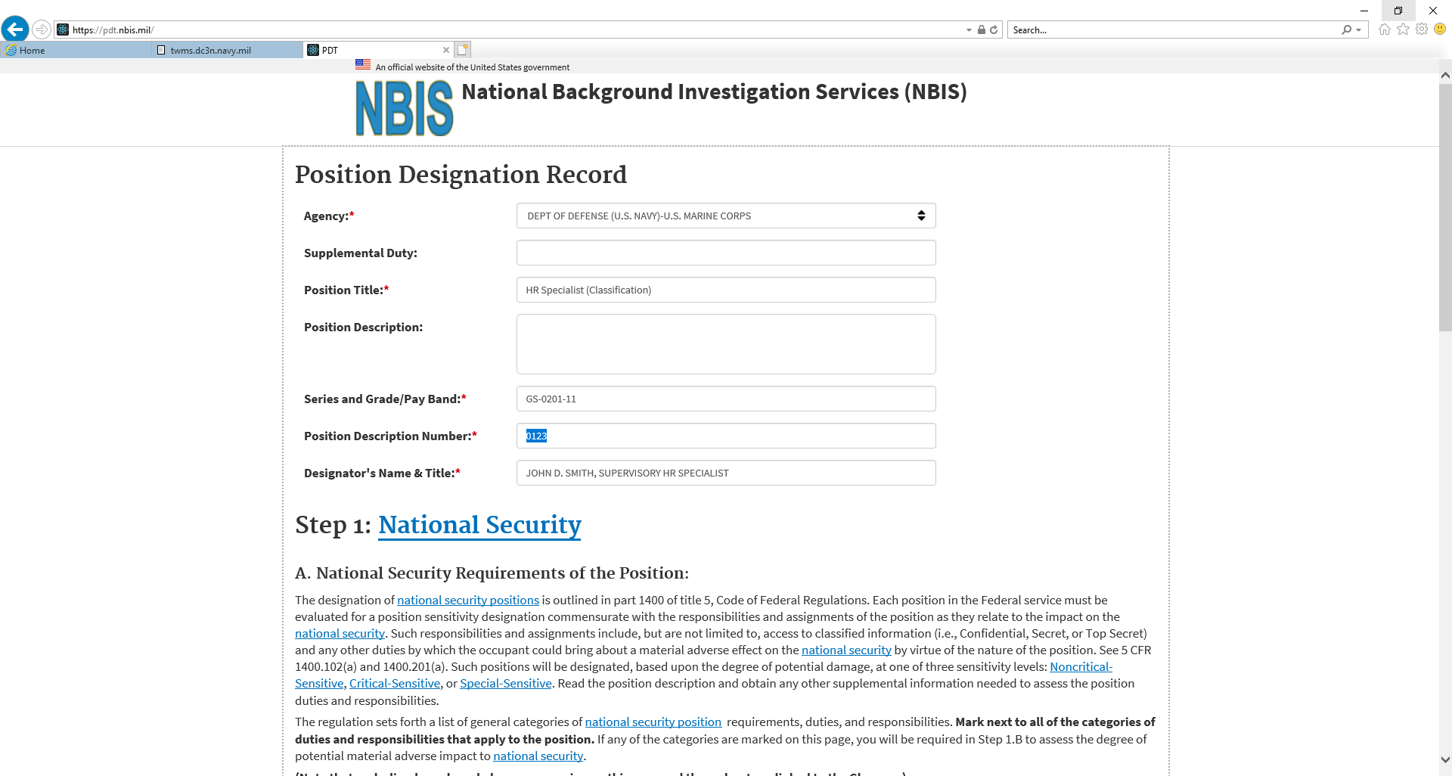
Position Designation Tool
AGENCY: DEPT OF DEFENSE (U.S. NAVY) – U.S. MARINE CORPS

Slide 5
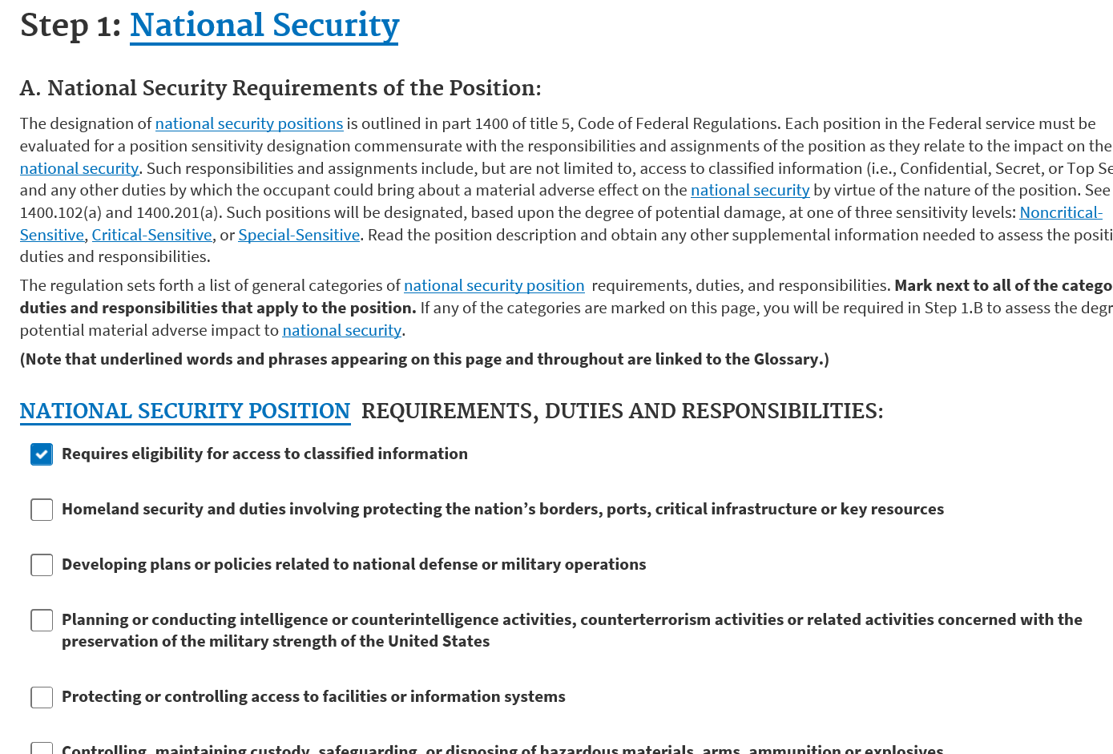
Position Designation Tool
CLASSIFIED INFORMATION SELECTION

Slide 6
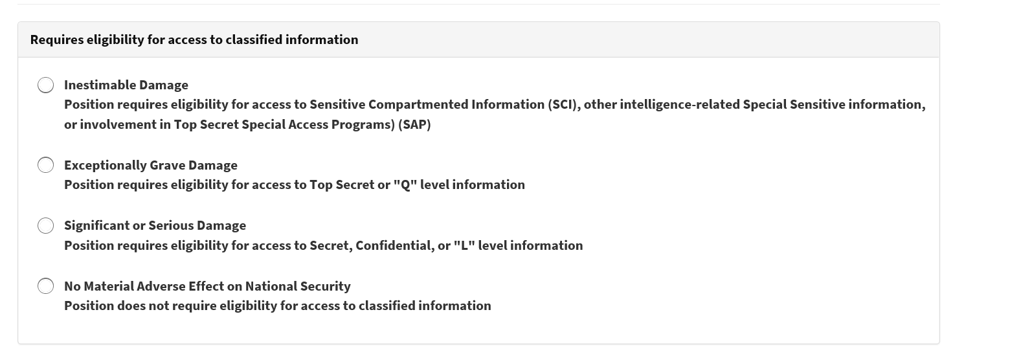
Position Designation Tool
Inestimable Damage – Select for Special Sensitive Positions
Exceptionally Grave Damage – Select for Critical Sensitive Positions
Significant or Serious Damage – Select for Noncritical Sensitive Positions
No Material Adverse Affect – Select for Non-Sensitive Positions

Slide 7
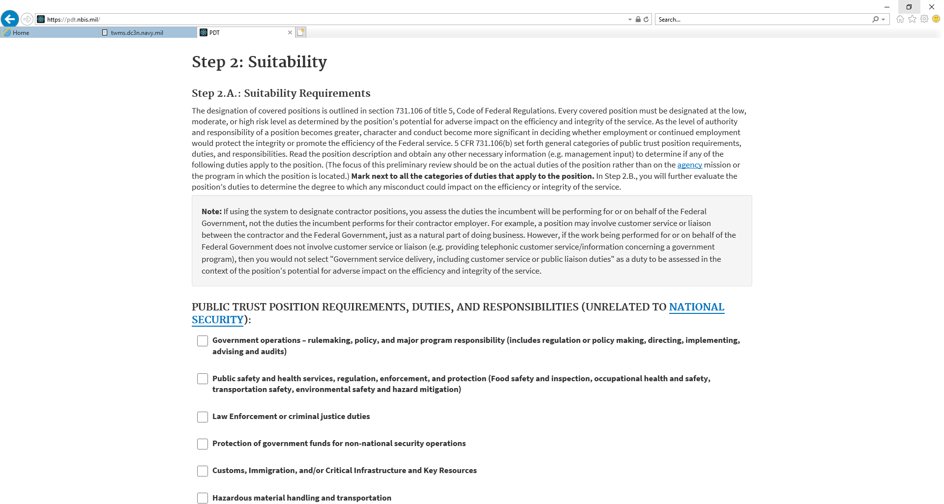
Position Designation Tool
Step 2 – Suitability Requirements (Select any that may apply to the position)
NOTE:
IF YOU SELECT
“NO PUBLIC TRUST DUTIES”
THEN THE PDT WILL GO
TO STEP 4

Slide 8
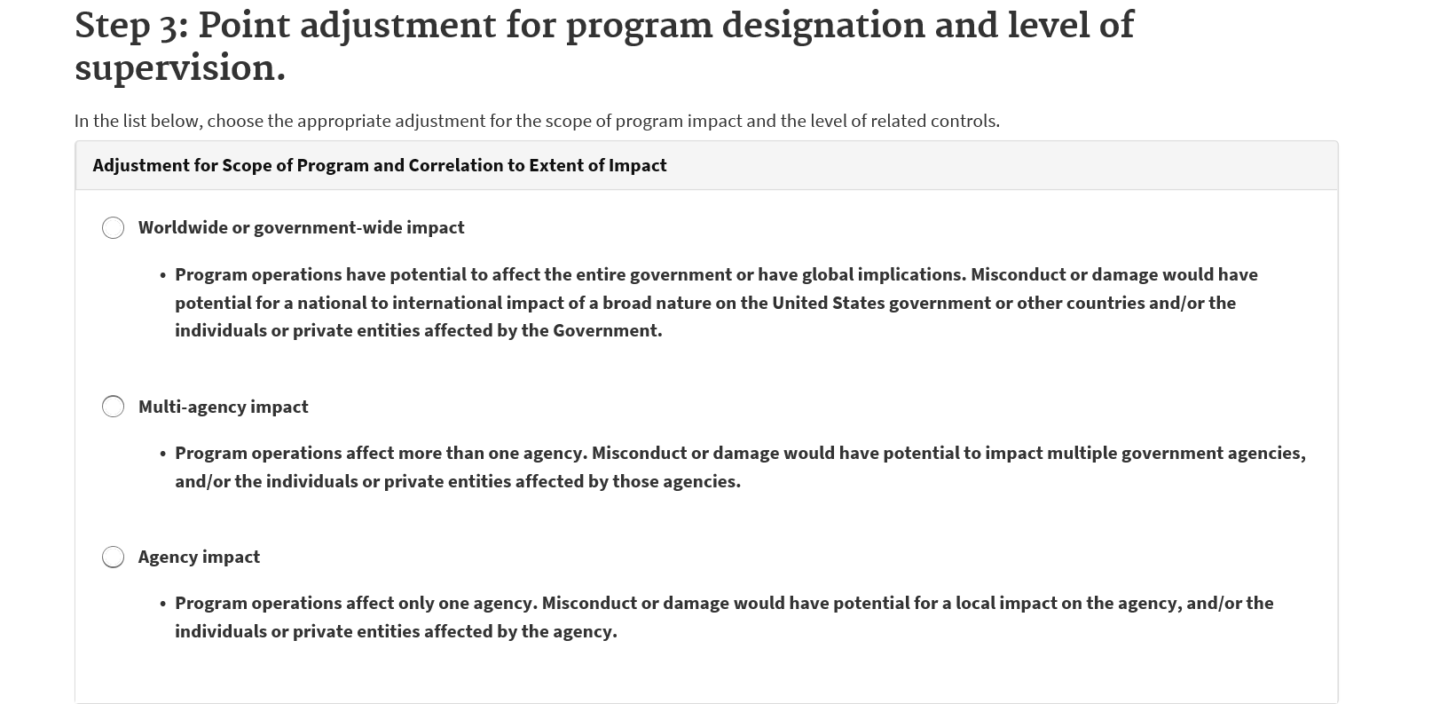
Position Designation Tool
STEP 3 – SCOPE AND EFFECT OF PROGRAM DESIGNATION
NOTE
IF APPLYING STEP 3
TO ANY PD THEN PLS
CONSULT WITH CHRO
CLASSIFICATION FOR
APPROPRIATE
SELECTIONS

Slide 9
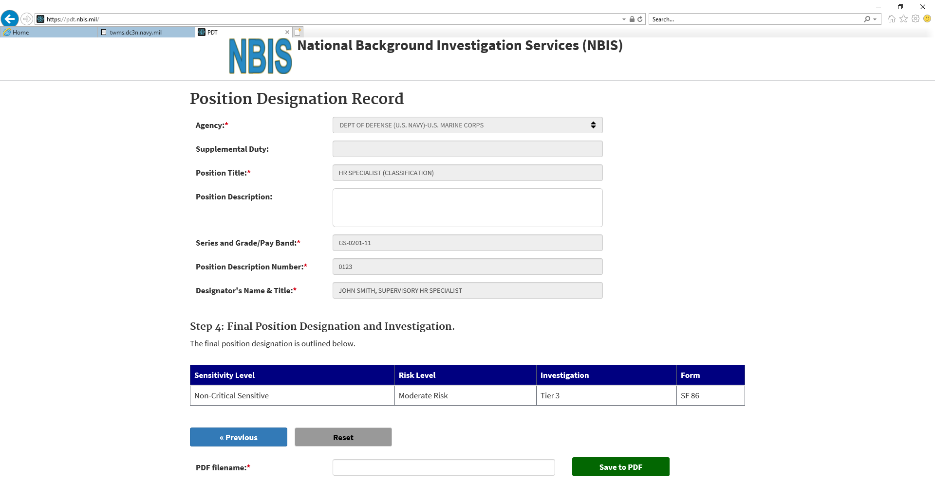
Position Designation Tool
STEP 4 – FINAL POSITION DESIGNATION AND INVESTIGATION
NOTE
TYPE IN PDF FILE NAME
THEN CLICK SAVE TO PDF
AND COMPUTER LOCATION
TO SAVE FILE. INSERT DIGITAL
SIGNATURE FOR SUPERVISOR
OVER THE POSITION TO
SIGN THE PDT.

Slide 10
Position Designation Tool
Links and Training Documentation
National Background Investigation Services (NBIS) Link
https://www.pdt.nbis.mil
New PDT OPM Training Video
https://youtu.be/LCrT_C_OIwg

Slide 11
Position Designation Tool
CHRO CLASSIFICATION SECTION POC’s
Phil Philbee (HR Specialist - Classification)
Email: phillip.philbee@usmc.mil; Phone: 645-3228
Mary Jane Kinjo (Classification and Wage Technician)
Email: maryjane.kinjo.ja@usmc.mil; Phone: 645-5021
Arnos Hunter (Lead HR Specialist - Staffing and Classification)
Email: arnos.hunter@usmc.mil; Phone: 645-5443

